Slide 1

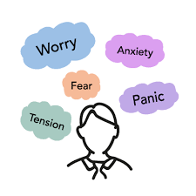



Anxiety Support
for Children and Young People and their Families
Notes:
This principle underlies the adult response to the children's often challenging behaviour – “distressed behaviour that challenges”. ‘Given what I know about this child and their development what is this child trying to tell me?' Understanding what a child is communicating through behaviour helps staff to respond in a firm but non-punitive way by not being provoked or discouraged. If the child can sense that their feelings are understood this can help to diffuse difficult situations. The adult makes the link between the external / internal worlds of the child.

Slide 2

Overview
Exploring Anxiety
Rationale and Context
Mental Health Continuum
What is anxiety – some definitions, potential causes and signs
Stigma
What can we do?
What works and what can you do?
Current NA supports
Models of resilience
Case studies
North Ayrshire Council

Slide 3
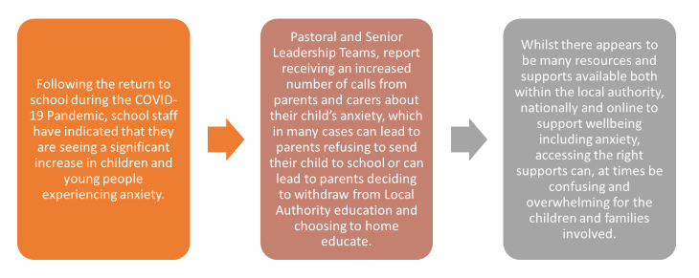
Rationale
North Ayrshire Council

Slide 4

Why now?
Disruption of education
Exam disruption – unknown future
Loss of friendship groups
Fear of virus
Bereavement
Family circumstances
Inappropriate activity
Lack of outdoor physical activity
Increase in caring responsibilities
Fear of unknown – what next
North Ayrshire Council

Slide 5

Context
Mental health problems are common in young people.
There is a high level of stigma associated with mental health problems and young people.
Many young people are not well informed about mental health problems.
A young person may not realise that they need help for mental health problems.
Many young people do not seek help for mental health problems.
Mental health problems interfere with adolescent development (SMHFA)
North Ayrshire Council

Slide 6
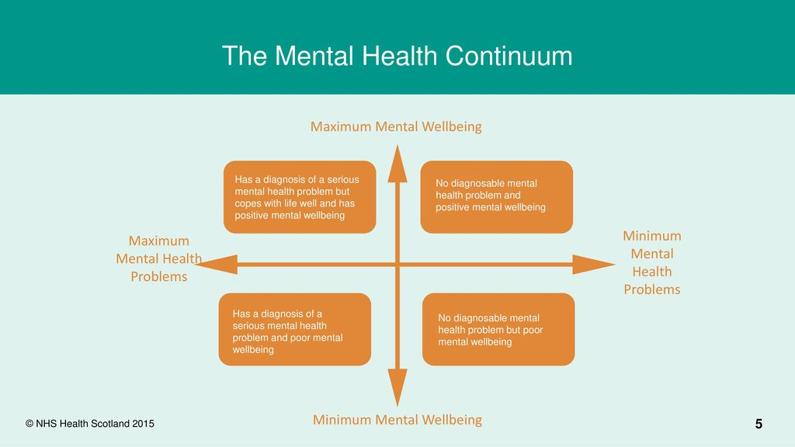
Notes:
IT IS IMPORTANT TO NOTE THAT ANXIETY CAN BE A NORMAL REACTION TO POTENTIALLY STRESSFUL SITUALTIONS AND EVENTS.
It can be a healthy stress response to feel anxious. A burst of adrenalin helps us get up and go in the morning, face our fears and provide evidence that ’we can do it’ rather than ‘what if.. ‘

Slide 7
What do we mean by anxiety?
Discuss in groups

Slide 8
What do we mean by Anxiety?
Definitions
YoungMinds.org.uk.
“Anxiety is a normal, human feeling of fear or panic. When we face stressful situations, it can set off our brain’s in-built alarm bell system, which tells us something isn’t right and that we need to deal with it. Our brain wants the difficult situation to go away, so it makes us feel more alert, stops us thinking about other things, and even pumps more blood to our legs to help us run away.”
Diagnostic and Statistical Manual of Mental Disorders, 5th Edition: DSM-5
‘The anticipation of a future concern associated with muscle tension and avoidance behaviour’ ‘Anxiety is a normal emotion which has evolved over time to keep us safe’ and it only becomes a problem when it is out of proportion to the situation, persists for 6 months or longer and interferes with ability to function normally. It involves thoughts, feelings, behaviour and bodily responses.’

Slide 9
Definitions Continued
Anxiety is the feeling elicited from fear when in response to an actual or perceived threat (Tovote, Fadok & Lüthi, 2015). For example, when presented with a stimulus perceived to be dangerous (e.g., a car coming towards us) we feel anxious, which elicits a fight or flight fear response (e.g., running away from the car) to keep us safe.
Although anxiety is a survival mechanism, there are those who experience this fear response chronically and excessively perceive danger in non-threatening situations (Kim & Gorman, 2005). This has led to increased prevalence of people experiencing anxiety disorders that require intervention. For example: Generalised Anxiety Disorder, Obsessive Compulsive Disorder, Social Anxiety Disorder, Post Traumatic Stress Disorder.
Social anxiety is an intense fear of embarrassment in social or performance situations. Leads to avoidance of social interactions which can lead to long term academic and social consequences.

Slide 10
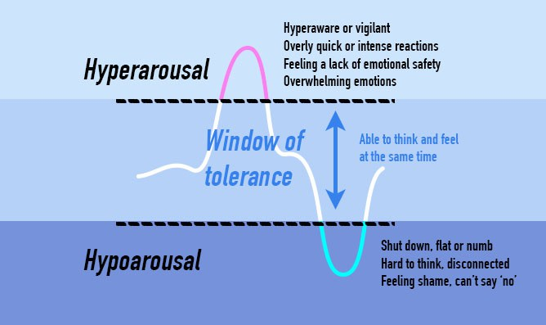
Window of Tolerance
Notes:
Video of window tolerance – Beacon House
In the window a person is regulated and outwith they are dysregulated so this describes emotional regulation.
Taken from: https://www.goodtherapy.org/blog/psychpedia/window-of-tolerance
Window of tolerance is a term used to describe the zone of arousal in which a person is able to function most effectively. When people are within this zone, they are typically able to readily receive, process, and integrate information and otherwise respond to the demands of everyday life without much difficulty. This optimal window was first named as such by Dan Siegel.
What Is the Window of Tolerance?
When a person is within their window of tolerance, it is generally the case that the brain is functioning well and can effectively process stimuli. That person is likely to be able to reflect, think rationally, and make decisions calmly without feeling either overwhelmed or withdrawn.
During times of extreme stress, people often experience periods of either hyper- or hypo-arousal. When people become anxious about situations their window of tolerance reduces and their coping mechanisms reduce and stress levels can increase so the are less able to function rationally.
Hyper-arousal, otherwise known as the fight/flight response, is often characterized by hypervigilance, feelings of anxiety and/or panic, and racing thoughts.
Hypo-arousal, or a freeze response, may cause feelings of emotional numbness, emptiness, or paralysis.
In either of these states, an individual may become unable to process stimuli effectively. The prefrontal cortex region of the brain shuts down, in a manner of speaking, affecting the ability to think rationally and often leading to the development of feelings of dysregulation, which may take the form of chaotic responses or overly rigid ones. In these periods, a person can be said to be outside the window of tolerance.
Each individual’s window of tolerance is different. Those who have a narrow window of tolerance may often feel as if their emotions are intense and difficult to manage. Others with a wider window of tolerance may be able to handle intense emotions or situations without feeling like their ability to function has been significantly impacted.
The window of tolerance can also be affected by environment: people are generally more able to remain within the window when they feel safe and supported.
Most people move between these varying states of arousal from time to time. Certain stimuli or events in the environment can narrow the window of tolerance and these can be different for different people. We wil look at this in the next slide.

Slide 11


What might cause anxiety?
Trauma
Bereavement
Breakdown in family relationships
Lots of change in a short space of time
School and Exams
Serious medical illness
Side effects of medication
Family history
Changes in brain chemistry
Poverty
Young Carer
Notes:
Remember, these types of events don’t necessarily cause anxiety, rather some types of events are good for us to experience in order for us to build resilience.
So these are not in any particular order and we know that any child who has experienced trauma at any point during their early lives- and that includes adverse childhood experiences- and any child coming from that background is highly likely to have some anxiety and certain things will trigger that anxiety to a much higher, to a much more heightened state.
And bereavement and we know that over the last 14 x months or so, we know a lot of our children have lost family members in the pandemic. Breakdown in family relationships or friendships, so again we know that there has been a much higher rate of family separation, we know that there has been a higher divorce rate and a lot of friendships being lost as people have been unable to meet up or do things together, and families that haven’t been able to see each other like children and cousins t be able to play together. We also know that there has been a huge increase in domestic violence and abuse and all that may be causing additional anxiety in a young person.
And if that young person has had lots of change in a short period of time, so it could be that that young person has had to move house 3 x times in the last 14 x months, because they have been evicted or unable to pay the mortgage or they haven’t been able to keep the housing that they have been in. Which has maybe meant that they have also had to change schools a number of times. So, all of that can cause anxiety.
School work and having to do exams. We know at the moment that although we are not having to do – “officially” exams there is an awful lot of youngsters who have actually been really, really anxious about not being able to do their exams. Worrying about the future. Worrying about – “Will my teachers’ grades be equal to……….” People coming through next year when exams are hopefully back on the table and going for jobs and university placements with a different set of grades or differently put together grades. And a lot of youngsters have been quite concerned about that. And we also know that there is a group of youngsters who have actually lost all motivation to learn because they haven’t got those exams at the end of the tunnel if you like. So, although they are doing internal tests and lots and lots of assessments going on, it was the actual exam if you like that was actually driving them to do their work.
People who have had serious medical issues- so those people who have been very, very ill can actually become anxious. Any side effects of medication. And we have a number of children who may be on medication for a whole variety of reasons and medical needs and again it may be that that medication is making that young person anxious or t might ne that there has been a change to the actual prescription. That could also cause some difficulties. Because that medication can also be impacting on the brain chemistry. And also within that is youngsters going through puberty and adolescence which we all know starts in the upper part of primary schools these days and not just in secondaries. And we know that when children go through adolescence their brain chemicals change during that time as well.
So all of this added in can have a real impact on young people.
Family history can also have an impact so if you have family members who have been known to experience highly anxious states, especially with younger children coming into school, we often find very young children coming into the early years and they are really, really anxious so they are almost at the point that they don’t want to do anything. They cry at the point of coming through the door, and all of that. And actually, if they have lived in a home for 3 or 4 x years where anxiety is the main personality trait if you like, they will arrive in the early years anxious as that is what they know. And so, it can be that learned behaviour from the family history.
Erm, anybody, any child that lives in poverty and we know now as we hopefully come to the end of the Pandemic that we know there has been a number of families that have had real difficulties in terms of over the last 14 x months – which includes food poverty and housing poverty – so we know that that is a real issue.
And we also know that we have a large group of children who are, or who have been young carers. And again during the Pandemic they may have had to look after siblings who have been at home during remote learning or they may have had to have looked after a family members who may have been self-isolating and wasn’t able to go out of the house at all so some of our youngsters may have had to deal with that which may have caused them to feel that they are falling behind with their leaning and so again it is that vicious cycle.
And of course we have been embedded in a global Pandemic for the last 14 x months so, yes it is great that the restrictions are starting to ease and we are looking towards the future, but we are not out of the woods yet and I think we will continue to see anxiety in our children and young people and also in our staff for a good way forward. Because the news is still highly about the Pandemic, it is about new strains that are coming in from various places and it is about, you know, we may have to go back to localised lockdowns. So there is still a good way t go and anybody who is following the statistics we hear this every day, although the fantastic news is that the numbers of deaths has gone down (absolutely brilliantly), the number of people who are actually contracting the disease- the virus- is actually pretty stable on a day to day basis. And we know that the vaccination programme is going really well but I think that we have to be prepared going forward for a while yet – you know we need to be aware of this.

Slide 12

Identification
It can be difficult to identify and measure anxiety in children and young people.
It is often difficult to identify when the general level of anxiety is associated with “growing up” becomes clinical anxiety as a mental health disorder.
General classroom observation, notable changes in behaviours plus information from everyone who knows the child or young person followed by the use of standardised assessment s (if appropriate).
Looking for signs and symptoms of anxiety.
North Ayrshire Council
Notes:
And it can be really difficult to measure and identify anxiety in children and young people as you can’t give them a test – it’s not something we can assess in terms of a test. As sometimes that anxiety can be related to things like growing up and associated with adolescence and puberty. With any change that they are going through or is happening in their lives, erm. But when it becomes clinical anxiety that we can actually label it as a mental health disorder. And of course, that then means that that has to be diagnosed by a clinician.
So, we are looking and observing our children – and that is one thing that I would say – it is about that general classroom observation. So, what we are looking for is those noticeable changes in behaviours plus finding out from people that know that child. You might be able to use some standardised assessments if you are thinking about some of their learning barriers that might be causing that anxiety- but in terms of just observing and watching for that anxiety it is very much about those observations. It is about looking for those notable changes in behaviour. And acting upon those as quickly as possible. And looking for the different signs and symptoms which we have in the next slide…….here….

Slide 13
Symptoms
Physical
Panic attacks, which can include having a racing heart, breathing very quickly, sweating or shaking.
Shallow or quick breathing or feeling unable to breathe.
Feeling sick.
Dry mouth.
Sweating more than usual.
Tense muscles.
Wobbly legs.
Kicking out.
Stomach / headache.
Getting very hot.
Emotional
Preoccupied by upsetting, scary or negative thoughts.
Angry, withdrawn, challenging.
Nervous, on edge, panicky or frightened.
Overwhelmed or out of control.
Full of dread or an impending sense of doom.
Alert to noises, smells or sights.
Worrying about being unable to cope with daily things like school, friendships and being in groups or social situations.
Worrying so much that it is difficult to concentrate and / or sleep.
North Ayrshire Council
Notes:
And this is not an exhaustive list – there is much more than is on the slide here. And again, you have two sides to this – you have physical symptoms and you have the emotional symptoms. So, it might be that someone feels they are having a panic attack so they might have very fast breathing, they might be sweating, shaking. It might also be that they have very shallow breathing so they feel that they can’t breathe properly. They might feel sick, tummy ache, dry mouth, shaky legs, kicking out. Getting very hot or very cold in fact.
On the other side we have emotional things like getting very angry, becoming more challenging or even more withdrawn. You can see that they get more nervous, or they get panicky or frightened. Like they are talking like there is this impending sense of doom or becoming very overly sensitive. So, they become very much more alert to noises or smells or things that you know may not have affecting them in ordinary times. And again, if parents and families start to talk to you about them not sleeping or eating again that may be a sign that there may be some anxiety. But for the teacher in the classroom, it is very much about observation. It is very much about observing those changes in behaviour. It is about observing those very small, perhaps what might be very minor changes in that young person or what they are trying to do.

Slide 14
Stigma
Stigma refers to when someone is viewed with
disapproval because of a particular characteristic, such as having a mental health issue.
Stigma relating to mental health means that
people with a mental health condition may be
viewed negatively, have assumptions made about them or discriminated against because of their mental health.
It can also result in people with mental health
concerns feeling shame, guilt, and being afraid to
tell others about their experiences. This can make it hard for them to access support and help.
(Reachout.com)

Slide 15
How can we reduce stigma in schools?
Community awareness campaigns – school newsletters etc
Curriculum based learning programmes - explicitly teach about mental health
Developing a safe and supportive environment
Modelling respect for those affected by mental health difficulties – by treating people with mental health difficulties as individuals, rather than defining them by their mental health.
Reachout.com
Notes:
What can you do to help reduce stigma?

Slide 16
What can you do?
Whole school approaches
?
Class and Groupwork Approaches
?
Individual Approaches
?
Notes:
Discussion here
Research tells us that interventions which can have a positive impact on both reducing anxiety levels and preventing anxiety from becoming a barrier in children and young people’s lives can be categorised as follows –
Whole school approaches
Class and Groupwork Approaches
Individual Approaches
What can you do at each of these levels?
Whole school
Class and Group work
Individual

Slide 17
What works?
Discuss in Groups
Research tells us that interventions which can have a positive impact on both reducing anxiety levels and preventing anxiety from becoming a barrier in children and young people’s lives can be categorised as follows -
Whole school approaches
Class and Groupwork Approaches
Individual Approaches

Slide 18
Current Available Supports in North Ayrshire
Let’s Introduce Anxiety Management (LIAM)
Exchange Counselling Service
School Counselling service
Psychological services
Child & Adolescent Mental Health Service (CAMHS) & Community Eating Disorder Service
Promoting Positive Relationships in all schools
Nurturing North Restorative Approaches
Health and Social Care Young Persons Support Team –
Youth Services/Workers resilience
Building on Positive Relationships (BPR)
Strengths Based Family Support
Family Learning
Notes:
Let’s Introduce Anxiety Management (LIAM) is intended to develop skills in the delivery of a Cognitive Behaviour Therapy (CBT) informed approach for the treatment of mild-moderate anxiety symptoms in children and young people. Several practitioners across North Ayrshire have been trained to deliver the approach to children and young people.
Exchange Service works collaboratively with Local Authorities across the UK to help them embed the psychological and emotional wellbeing of children and young people into a whole school approach in both primary and secondary schools. Also, the service offers wellbeing counselling and guidance for schools and colleges, and offer training, group work and workshops.
School Counselling service for children aged 10-18 years old and is delivered across North Ayrshire and Arran. This service is provided across Primary and Secondary schools and is offered on a 1-1 or group work basis. Counsellors work with a diverse range of issues impacting young people, including supporting Anxiety. Overall, this service aims to support pupils emotional, behaviour, and mental wellbeing.
Psychological services are well placed to support schools, families and children and young people with a variety of barriers to learning. With regards to Anxiety, several approaches can be offered including solution-oriented consultation, exam stress workshops and professional learning regarding Anxiety as part of a series of neurodiversity modules https://www.northayr-edpsychs.co.uk/neurodiversity/
Child & Adolescent Mental Health Service (CAMHS) & Community Eating Disorder Service (CEDS) take referrals for and work with children and young people whose anxiety significantly impacts their lives. They provide a service to children and young people with severe and complex mental health disorders through both pharmaceutical and therapeutic approaches.
Promoting Positive Relationships in all schools, North Ayrshire Education Service Promoting Positive Relationships Policy has been written to help educational establishments further embed and strengthen our Nurturing North Ayrshire approach. It follows national guidance that all local authorities should have a relationships policy which should inform individual school policy. It aims to impact positively on all learners and support all staff to meet need.
Nurturing North Ayrshire (whole school and targeted nurture) Nurture is Central to Health and Wellbeing education in our schools; integral to the GIRFEC approach in building confidence and emotional resilience. Nurture plays a vital role in overcoming disadvantage in order that our young people are successful as effective contributors to society as learners, employees, parents and carers.
Restorative Approaches - A restorative approach uses authoritative discipline to promote accountability and seeks to repair any harm caused in a situation. Restorative approaches also help schools to create peaceful learning environments for children and young people.
Health and Social Care Young Persons Support Team - The Young Person Support Team is an Early and Effective Intervention Service which prides itself on building and maintaining relationships with the purpose of diverting vulnerable young people and their families from statutory services. Through improving Mental Health and Wellbeing the YPST strives to provide a positive impact on young people’s health and wellbeing, confidence and self-esteem levels through focused group work activities and individual supports
Youth Services/Workers resilience training – the Connected Communities Youth Work team deliver group work sessions based on the Bloom – Your Resilience programme which aims to equip young people with the tools and knowledge to maintain their mental health through life’s transitions – such as moving through school, changing friendship groups, moving to university or starting employment.
Building on Positive Relationships (BPR) - based around the principles of NVR (Nonviolent Resistance) and utilising- our current relational approaches this model should be helpful in working with families where children were resistant to other models of support.
Strengths Based Family Support - a multiagency, holistic, strengths focussed community-based assessment and support service for families, within two test of change localities; building on the wealth of skills within North-Ayrshire Council HSCP and Communities & Education Directorate. Staffed by our current team of 4 SNAP workers who assess need, deliver family wellbeing support programmes and if appropriate signpost to alternative family wellbeing supports identified through a menu of supports.
Family Learning Team - The Family Learning Team work in partnership with schools across North Ayrshire to provide opportunities for family learning including support with health and wellbeing.
The curriculum resources mentioned previously all support mental health awareness with some focussing on nurturing resilience and developing coping strategies. Need to list curriculum resources again possibly and say how they are used in NA

Slide 19
What do we mean by resilience?
Resilience may refer to:
the capacity to manage future adversity
coping well during adversity
recovering well from adversity
An
outcome
Resilience
A set of
qualities
or processes
A capacity
Parenting and resilience Hill et al (2007)
Notes:
Resilience as an outcome: when people do better than expected e.g. doing as well as someone without adversity or being less affected than others going through the same situation-so a child leaving care with qualifications from school could be seen as resilient. It can also mean being affected but doing well afterwards. Another example could be a pupil missing out on the right qualifications for University but going to College and reaching their goal – the road is longer but they are stronger because of it. Gilligan speaks of the continuum from survival to coping to thriving.
Resilience as a set of qualities or processes: that enable a person to make use of internal and external resources: working in partnership with others; speaking up when things are difficult; recognising success doesn’t always happen first time; appreciating that life is ever-changing both positively and negatively.
Resilience as a capacity that causes the good outcome: we remain strong; we acknowledge the negatives we experience; we observe emotions such as sadness and fear but know that these do not need to be permanent. Change has no delivery window, we cannot schedule when something good or bad is going to happen but we can utilise our strengths to manage them.

Slide 20
Relationships are key…
Researchers analysing teenagers dealing well with adverse painful events found that a sense of connectedness to at least one adult was a key aspect to developing resilient behavior.
It was equally valuable whether it happened in the family, in the community, or within school (Howard and Johnson, 2000).
Our children and young people in North Ayrshire recognize the importance of having at least one trusted member of staff in school.
North Ayrshire Council
Notes:
Relationships and attachments must be positive. If they are fractured or inconsistent resilience is harder to cultivate and sustain. This has already been recognised in previous slides and through the research findings you have learned about today.
Read slide…
In late 2019 a number of pupils across several North Ayrshire primary and secondary schools took part in focus groups which centred around mental health and what children and young people think are the keys to maintaining positive mental health. It was recognised by all groups that having at least one key adult in school who they know they could turn to makes them feel better and more able to cope on a day to day basis. The benefit of knowing if staff had completed any training relating to mental health would make the school environment feel safer and more secure.

Slide 21
A Model of Resilience
There are 3 different categories of resilience;
  I have’s – our external factors
  I am’s – our internal factors
  I can’s – our social factors
Knowing which category is affected can help tailor the support for the young person. For example, I have’s would be affected by family anxiety, I can’s by social anxiety.
Self-reflective insight and self-regulation are two resources of resilience that can help with anxiety.
Notes:
Child welfare academics who have focused on developing models for the practical application of resilience theory identify three fundamental building blocks of resilience
1. A secure base whereby the child feels a sense of belonging and security
2. Good self-esteem, that is, an internal sense of worth and competence
3. A sense of self-efficacy, that is a sense of mastery and control, along with an accurate understanding of personal strengths and limitations
Alternatively these can be expressed as “I HAVE…, I AM…, I CAN… ”
I have: Social and Emotional Supports/ Awareness of Those who Support Them/ Who I have
Secure base
I have…
People around me I trust and who love me no matter what
People who set limits for me so I know when to stop before there is danger or trouble
People who show me how to do things right by the way they do things
People who want me to learn to do things on my own
People who help me when I am sick, in danger, or need to learn.
I Can: Interpersonal and Problem Solving Skills/ Degree of Confidence They have in their own Abilities/ What Can I Do?
Self efficacy
I can…
Talk to other people about the things that frighten or bother me
Find ways to solve the problems I might face
Control myself when I feel like doing something that’s not right, or that’s dangerous
Figure out when it is a good time to talk to someone, or to take action
Find someone to help me when I need it.
I Am: Inner strength/ How they view themselves/ Who I am
Self esteem
I am…
A person other people can like and love
A person who is happy to do nice things for others and able to show my concern
A person who is respectful of myself and of others
A person who is willing to be responsible for what I do
A person who is sure that in the end things will be alright.

Slide 22
Self-reflective Insight
Self-reflection without insight is unhelpful; there needs to be a balance.
Often the causes of concern are really vague“everything makes me anxious” or there’s no obvious cause “nothing is making me anxious and yet I still feel anxious”. It’s impossible to set goals and create meaningful action if the cause is so unclear, so asking a young person to set out some of their concerns, and perhaps also their underlying fears, can be a really helpful step.
Insight can be thought of as a ‘shift in perspective’ or new understanding: it arises when we can place our experience in context.

Slide 23
Self-regulation
When we are in a state of hyperarousal (flight/ fight/ freeze/ fawn) we feel anxious, angry, overwhelmed, depressed, unmotivated and our actions are automatic, our reactions take over.
But when we are able to self-regulate, we enter a window of tolerance, we feel that we can deal with whatever is happening in our lives. We might feel pressure or stress, but we’re not unduly bothered by it.
Self-regulation may look like mindfulness, breathing exercises, getting outside, drawing, physical exercise, etc. It is an individual thing; we all self-regulate differently.
Exploring different ways of self-regulating with young people can be very helpful.

Slide 24
Case Studies: what would you do?
Robert is in your register class. You have noticed he is starting to avoid his friends and sits alone at break times. He confides in you that he is worrying about being unable to cope with daily things like school, friendships and being in groups or social situations.
Heather is 14 and you notice she is acting differently lately. She used to be outgoing and popular. Now she is quick to get angry and upset and has been storming out of classes. She has let her school work suffer but says she doesn’t care.

Slide 25
Useful resources
You may find the following slides useful when thinking about how you might support children and young people in your school/class.
The poster can be displayed in communal areas around the school. The video can be shown as part of PSE

Slide 26


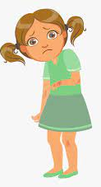
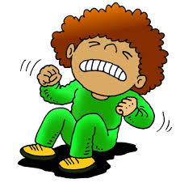


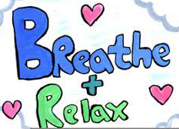
A short guide to anxiety
What is anxiety?
Anxiety is a normal emotion which is designed to keep us safe. It can sometimes be described as fear, worry, nervousness or panic. Everyone has anxiety at times in their life.
Anxiety becomes a problem when it lasts for a long time or it interferes with our ability to do things in our daily life which we usually enjoy.
Some examples of situations which can make us feel anxious are a job interview, an exam and meeting new people. Most of us will have experienced some anxiety as a result of the Covid-19 pandemic.
How can anxiety affect you?
Anxiety in small doses can help us to perform better and motivate us to get things done. E.g. in an exam or driving test however sometimes it can be overwhelming and affect us physically and emotionally.
We may think that avoiding these situations can help in the short term. Long term this can make it worse as the anxious thoughts and feelings are reinforced. We often have to complete the exam etc to know that the anxious feelings will pass.
Behaviours may include hitting out at others or avoiding situations.
Physical sensations may include vomiting, headaches and tears.
What can help?
Anxiety can be caused by lots of different things and can be difficult to control at times. It is important to know that there are ways of managing it.
There are many things that we can do to help ourselves and our children to manage this anxiety. Many of these might be individual to you but there are evidence based approaches that can help.
Strategies to help manage anxiety
It is important to find something that works for you. Remind yourself that this feeling will pass and think about how you will feel afterwards. You will feel better and calmer once it is over.
Ask for help - in some situations when you get stuck it can be useful to get help from professionals.
Anxiety is a normal emotion experienced by almost everyone. There are many things we can do to manage it when it does occur.
Deep breathing
Exercise
Think of a time when you have done it before
☺ We all feel anxious at times. There are many things we can do to manage our anxiety. ☺

Slide 27
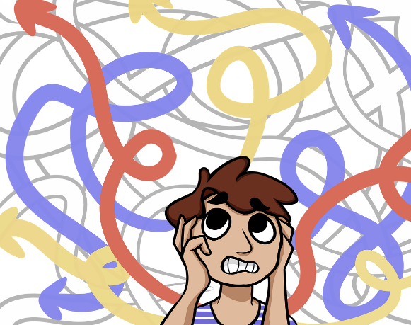
Video
sho.co for Sparkol

Slide 28
Next Steps…
Some reflective questions
How might you use the suggested resources in your setting?
How might you use the PowerPoint and accompanying workbook with staff teams?
How will you involve parents?

